Slide 1
The Elements of
Music

Slide 2
To begin…
Music has been defined as the organization of sound in time.
All sound is produced by the vibration of an object that excites the air around it. This vibration creates a wave that we hear as sound.

Slide 3
Properties of sound
Dynamics- How loud is it?
Pitch- How high is it?
Duration- How long does it last?
Timbre- What does it sound like?
Don’t forget about sound’s counterpart: silence.

Slide 4
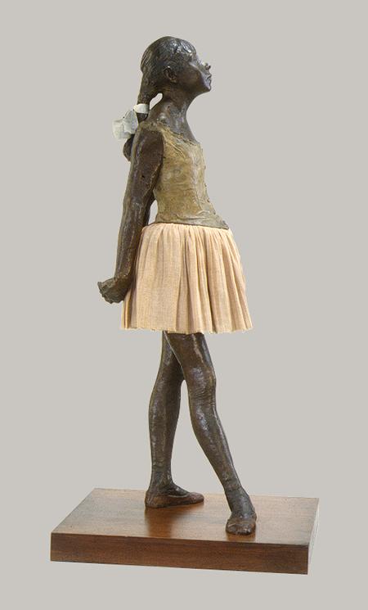
Sound and silence
We can compare sound and silence to positive and negative space in a sculpture.

Slide 5
Seven elements of music
Dynamics
Timbre
Melody
Harmony
Rhythm
Texture
Form
Not ALL music will contain ALL of these elements. However, ALL music can be described using these basic terms. Some are more important than others in different types of music from different places and times.

Slide 6
Dynamics
This term is used to describe not only how loud or soft a sound is, but also the ways that music becomes louder or softer. Many musicians use Italian words to describe dynamics. For instance, piano means soft and forte means loud. Crescendo means becoming louder and decrescendo or diminuendo mean becoming softer.

Slide 7
Bela Bartok’s Concerto for Orchestra demonstrates very dramatic dynamics.
https://www.youtube.com/watch?v=9uwpuyc7nS4
This video includes the score which represents in Western notation all of the music that the instruments in the orchestra are playing. We read music left to right just as we read written English.

Slide 8
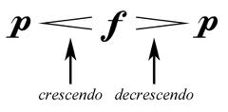
Symbols used to show dynamics
We could compare the dynamic levels of music to the saturation levels of color in painting.

Slide 9
Timbre
Round
Dark
Crisp
Hollow
Bright
Metallic
Wooden
Thin, etc.
This term describes the specific tone color of any sound. We often describe timbre using other sensory adjectives. Here are a few examples:

Slide 10
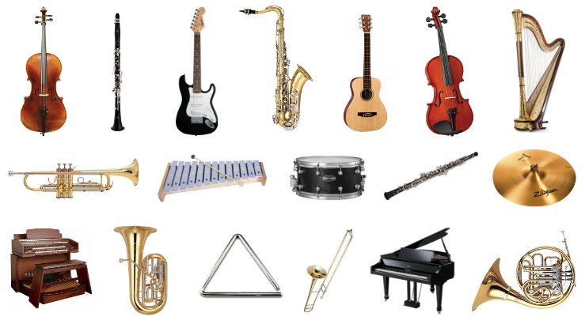
Timbre is a result of the acoustic properties of the object, instrument or voice producing the sound. Here are some examples:

Slide 11
Melody and harmony
Both elements are built of pitches, which are sounds that have pitch. We can also call these notes or tones.

Slide 12
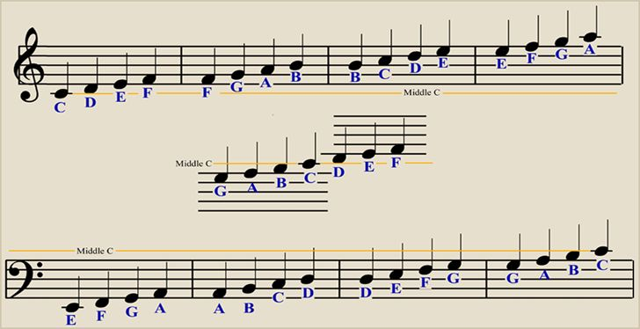
Pitches in Western notation are represented by note heads on a staff. A clef indicates where on the staff specific pitches are located.

Slide 13
https://youtu.be/YGRO05WcNDk
Frederic Chopin’s
Nocturne Op. 9 No. 2
contains both melody and
harmony at the same time.

Slide 14
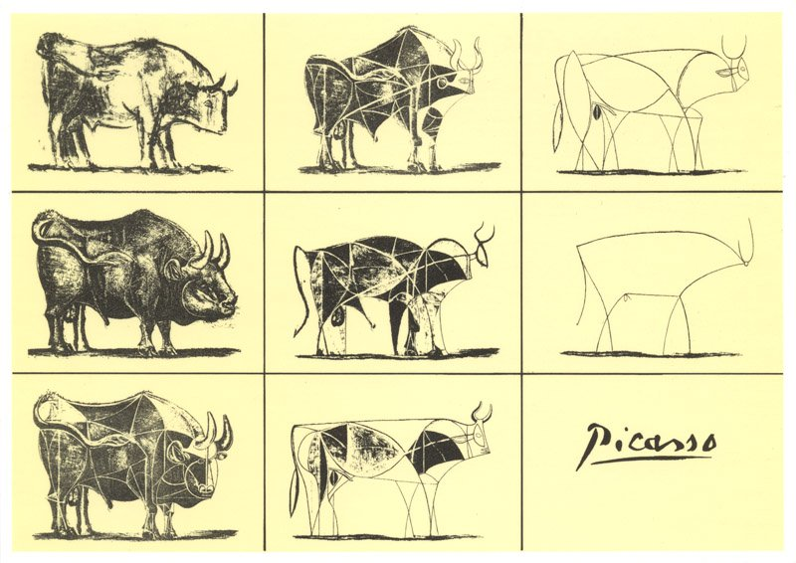
Melody is when pitches occur one after the other. We can think about it horizontally. We might compare it to a line in painting or drawing.

Slide 15
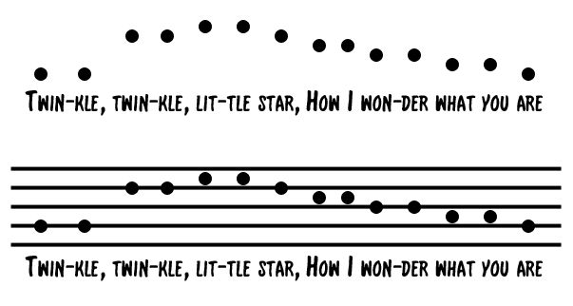

Slide 16
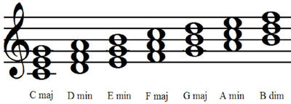
Harmony occurs when pitches happen at the same time. We can think about it vertically.
Harmony can be described as either consonant, which means pleasant and stable, or dissonant, which means unpleasant and unstable. Pictured here are groups of three pitches that we call chords.

Slide 17
Many of us would find the harmony in Chopin’s nocturne to be mostly consonant. However, we might find the harmony at 3:30 in Igor Stravinsky’s The Rite of Spring to be dissonant.
https://www.youtube.com/watch?v=rP42C-4zL3w

Slide 18
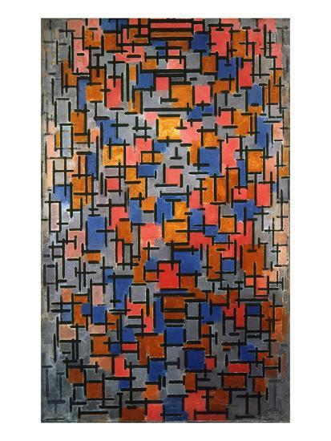
We might compare harmony in sound to the effects of using color in painting. This is a painting by Piet Mondrian.

Slide 19
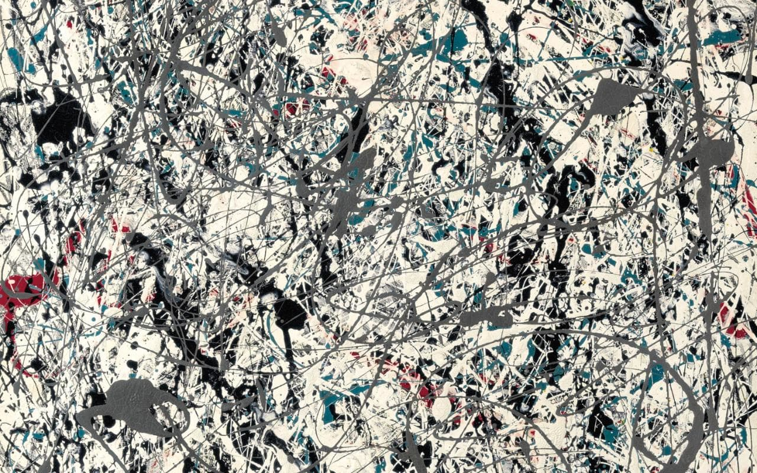
Rhythm is defined as the patterns of sound and silence in time that occurs in music. We might perceive rhythm in a work of visual art as our eyes move across and around it. This is a painting by Jackson Pollock.

Slide 20
Rhythm is the element of music that makes us want to move or dance.
https://www.youtube.com/watch?v=yeZHB3ozglQ
Tempo refers to the speed of the beat in music.
Much of the music that we love uses rhythm that is controlled by a beat, or a steady pulse. When beats are organized in groups that we can perceive through accent on a strong beat followed by varying numbers of weak beats, we say that music has a meter.

Slide 21
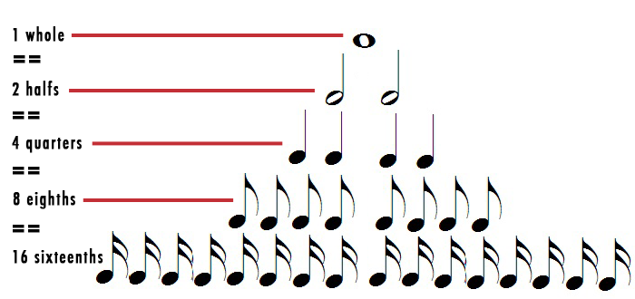
Western notation uses stems and flags to denote relative durations of notes.

Slide 22
Musical form is defined as the organization of the sequence of events in time.
Some musical form can be perceived fairly rapidly, as in the verse/ chorus form of many songs. The blues is often defined in terms of its musical form.
https://www.youtube.com/watch?v=V6hQ9HSKlIE
Other musical forms, like sonata allegro, may take more concentrated listening and longer timeframes.
https://www.youtube.com/watch?v=l45DAuXYSIs

Slide 23


Musical texture is the fabric of sound that results when the other elements interact with one another. We can easily relate it to the texture of textiles.

Slide 24
Musical texture is often described according to the number and relationship of musical lines occurring in it.
Monophonic
Homophonic
Polyphonic
One melodic line, on its own with no harmony.
One melodic line which is most important, but it has supporting harmonic and rhythmic elements.
Several, equally important melodic lines, often with varying rhythms.

Slide 25
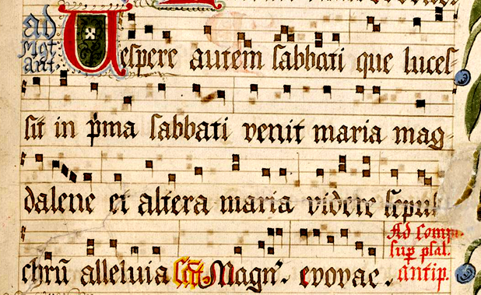
Monophonic Gregorian chant is some of the earliest Western music for which we have strong evidence.
https://www.youtube.com/watch?v=VqZ3kwdqtVY

Slide 26
Around the 11th and 12th centuries A.C.E., polyphonic chant appeared. This led to debates about how well the listener could understand the words that were being sung. Advances in the architecture of the Gothic cathedral were also relevant to the development of polyphony.
Perotin was a composer who is associated with Paris's Notre Dame cathedral. He was crucial in the development of this new type of chant called organum. Try to notice when the voices move independently of each other.
https://youtu.be/2IwXtqYM-Wk

Slide 27
Chopin’s nocturne is homophonic. So are most recordings of the songs we love. Richard Smallwood’s “Total Praise” is a beautiful example.
https://www.youtube.com/watch?v=jCjaUwEsMdQ

Slide 28
To conclude…
Dynamics
Timbre
Melody
Harmony
Rhythm
Texture
Form
As you listen to the music, see if you can perceive the seven elements of music we learned about.

